Slide 1

Credit Card Fraud Detection:
An Approach by Goon

Slide 2
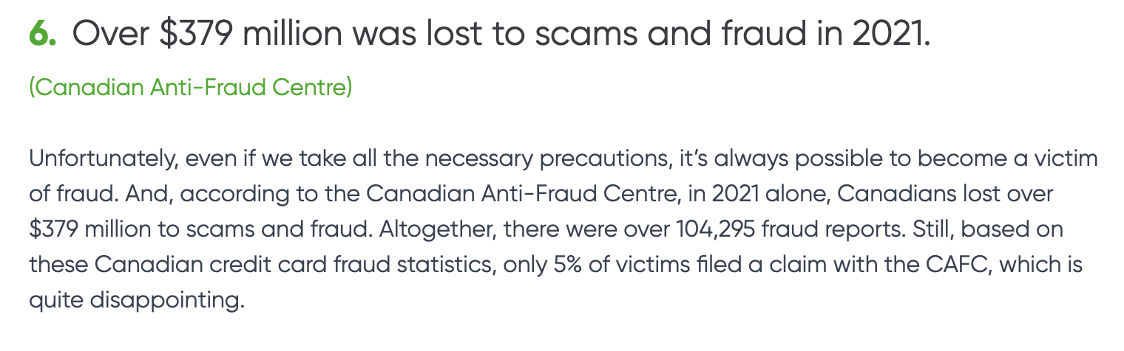
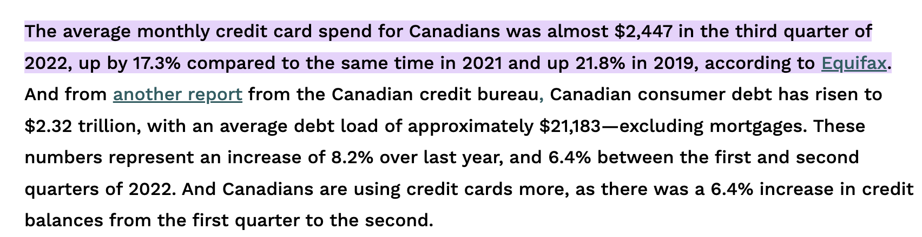
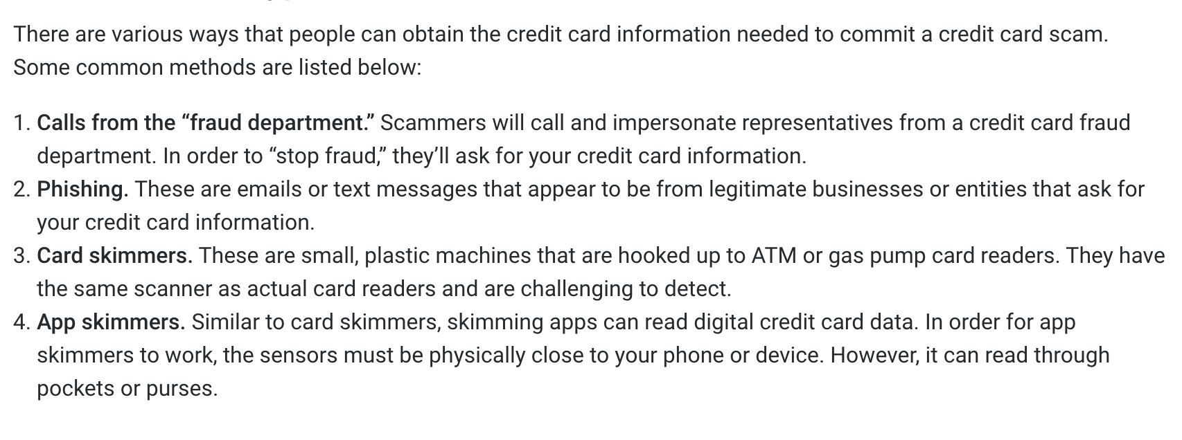
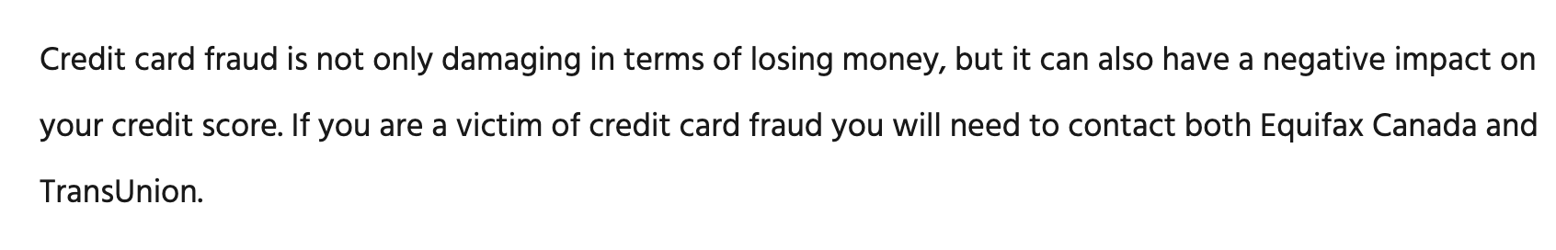
What is the impact of credit card fraud?

Slide 3
To answer this question, we ventured into many datasets
And observed different methods to make predictions as well as their advantages and limitations

Slide 4
1
Utilizing Business Insights to Choose Features
K-Nearest Neighbour vs Random Forest
2
3
Choosing Language
4
Data Pre-processing
Our Process
5
Visualization

Slide 5
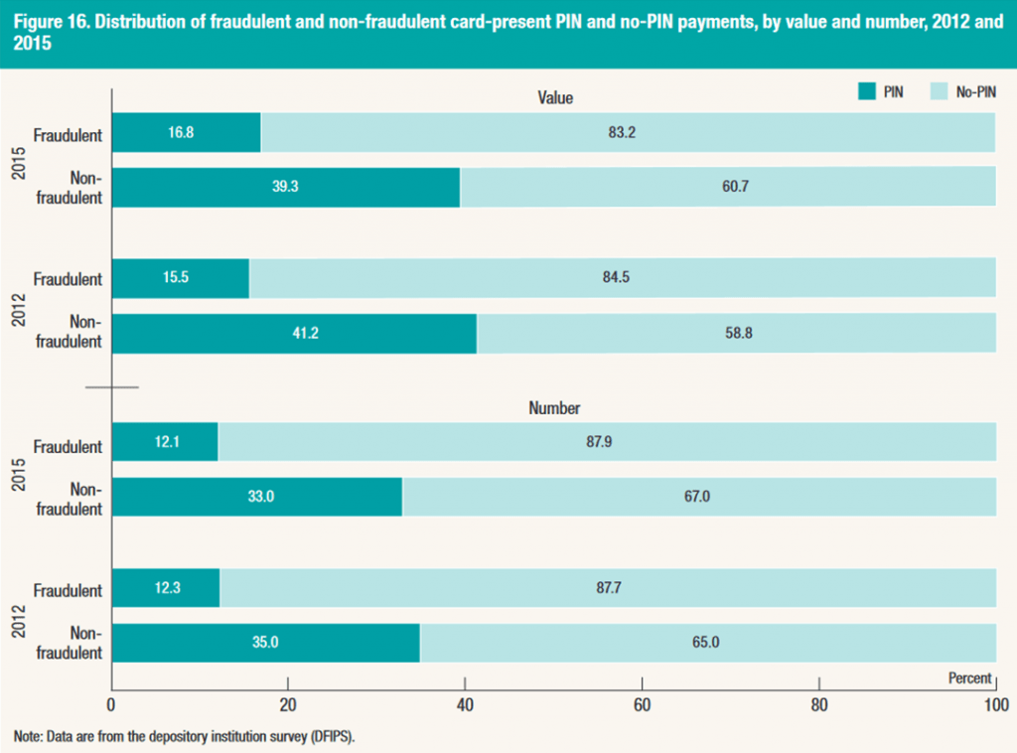



1
No-Pin vs Pin
We cannot account for this, there’s too much operation overhead
2
Company Behavioural Analytics
Companies use machine learning to create user profiles including typical spending days/hours, consumers preferred industry of purchase, changed passwords, changed addresses, etc.
3
Geographic Distribution
Only 13.31% of total city rows is included and we might not have a location for previous transactions
Number | 2253 | 3293 | 1337 | 796 | 158 | 301 | 657 | 136
Rate | 51 | 98 | 71 | 77 | 37 | 87 | 77 | 61
City | Toronto | Montreal | Vancouver | Ottawa | Kitchener | Halifax | Calgary | Saskatoon

Slide 6
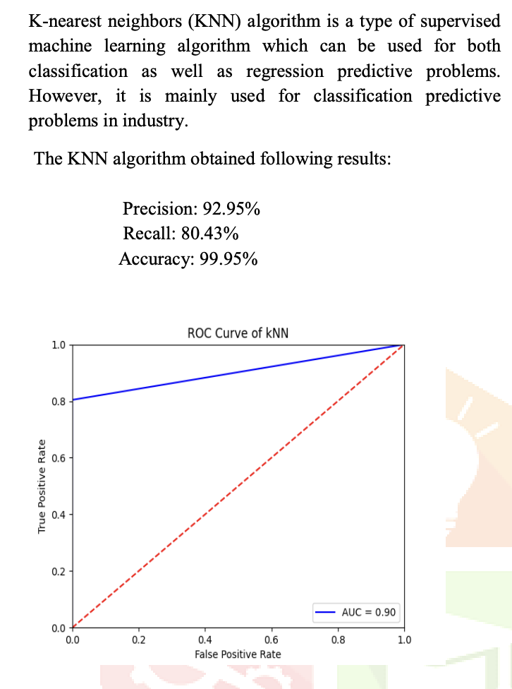
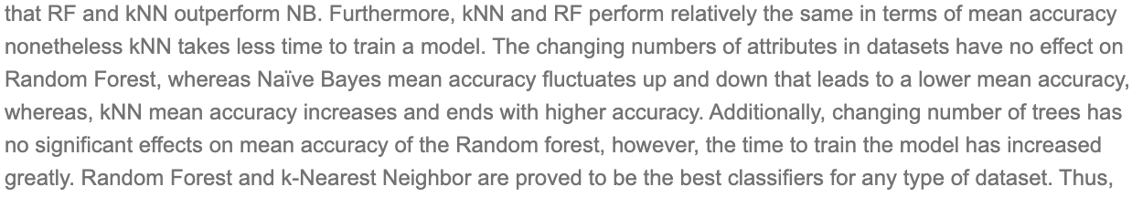
KNN
KNN was faster to program for us, and data processing time, along with data reduction techniques

Slide 7

Python
Python was similarly faster to program for us while having the benefit of scikit and pandas

Slide 8


Data Pre-processing
Normalization
Everything in the categorical columns: flags, transaction id, geographical locations, time had different units. Everything in continuous columns was in dollars.
PCA
This reduced noise in the data for us, had a minimal effect on variance and allowed our data to be more comprehensible. We choose 74 columns in total.

Slide 9
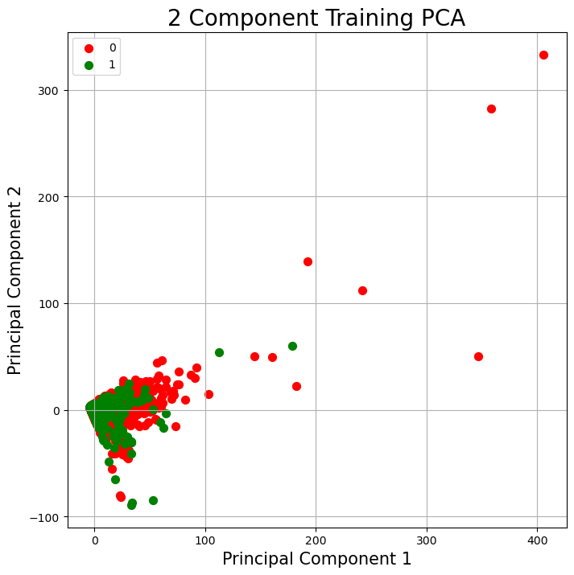
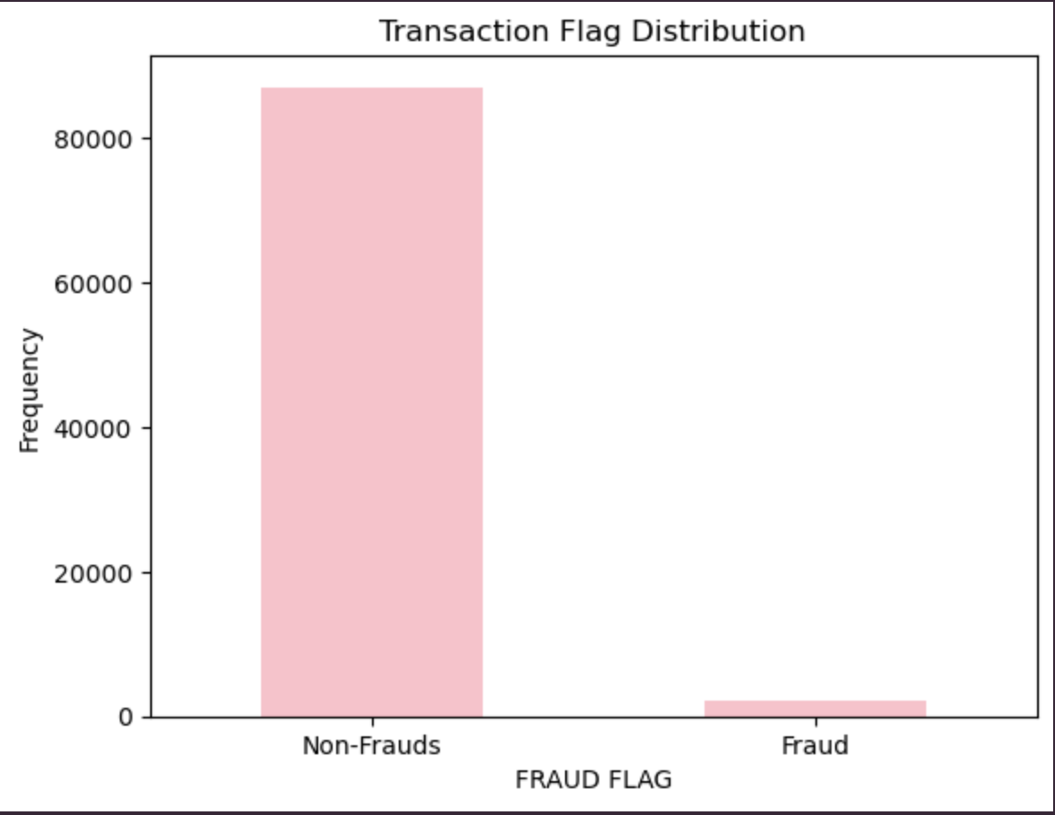
It allowed us to determine differences between sample sizes and neighbours needed
Visualization

Slide 10
The End
Any Questions?

